Slide 1
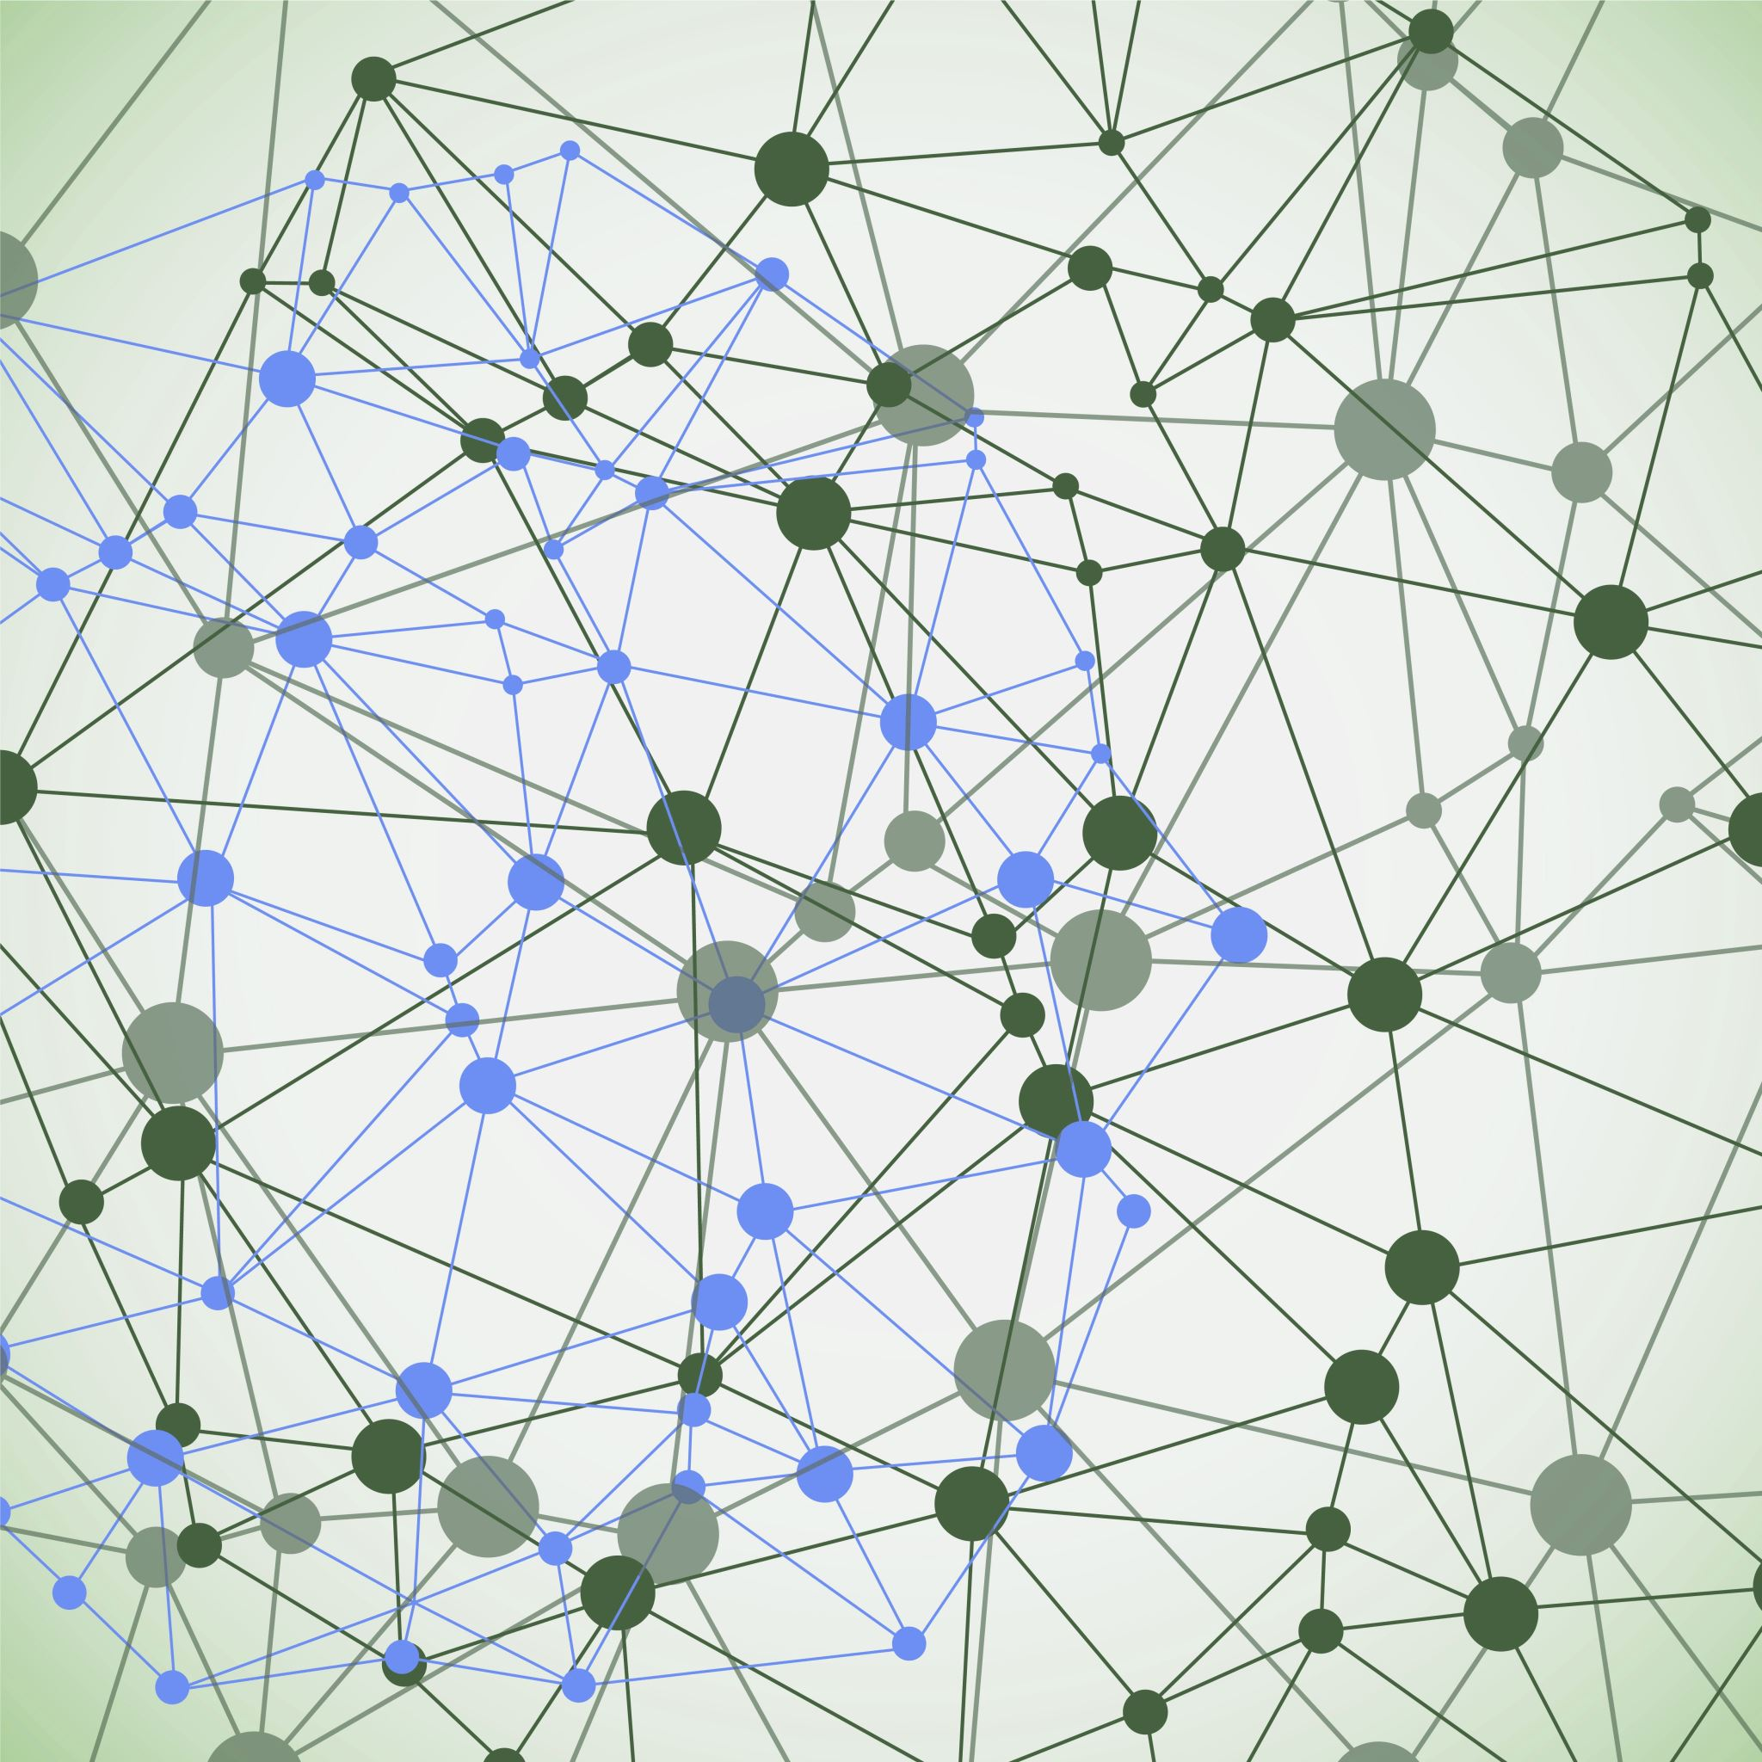
SYNAPTIC METAPLASTICITY IN BINARIZED NEURAL NETWORKS
Paper:
Laborieux, A., Ernoult, M., Hirtzlin, T. et al.. Nat Commun 12, 2549 (2021).
Ana Milena Forero Pinto
Computational Neuroscience exam
Quantitative Life Sciences Diploma program . ICTP

Slide 2
A LITTLE BIT INTO CONTEXT

Slide 3
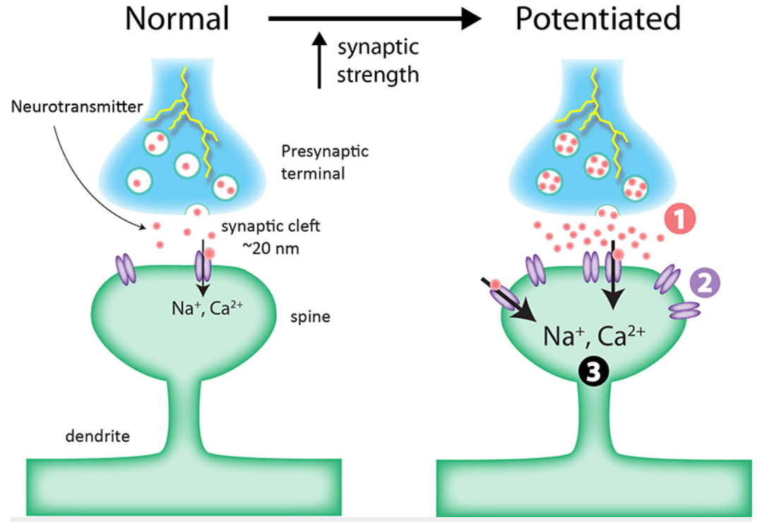
The role of plasticity in memory storing
Synaptic plasticity refers to changes in synaptic strength.
Memories are stored through synapse modification.
The process of weakening and strengthening connections changes the connectivity of the brain.
Stored memory traces degrade over time due to ongoing plasticity.
From: Long-term synaptic plasticity - Queensland Brain Institute –University of Queensland (uq.edu.au)

Slide 4


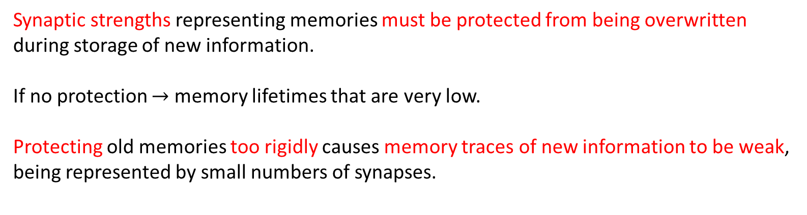
The role of plasticity in memory storing (Plasticity – rigidity dilemma)
Synaptic strengths representing memories must be protected from being overwritten during storage of new information.
If no protection $→$ memory lifetimes that are very low.
Protecting old memories too rigidly causes memory traces of new information to be weak, being represented by small numbers of synapses.
Storing new memories
Retaining old memories
Highly Plastic Synapses
Less Plastic Synapses

Slide 5
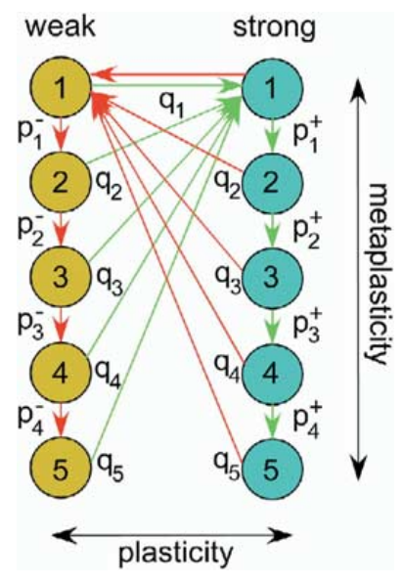
Cascade models of Synaptically Stored Memories
Metaplasticity is a modulation of the synaptic plasticity by prior synaptic activity. (plasticity of the synaptic plasticity).
Cascade models introduce power-law rather than exponential forgetting. (power-law decay of the memory trace over time.)
High levels of memory storage + long retention times.
The cascade model allows correlations in the pattern of potentiation and depression events at a single synapse to affect the degree of plasticity.
Stefano Fusi, Patrick J. Drew, L.F. Abbott. Neuron.
Volume 45. Issue 4. 2005. Pages 599-611.

Slide 6
THE PROBLEM

Slide 7
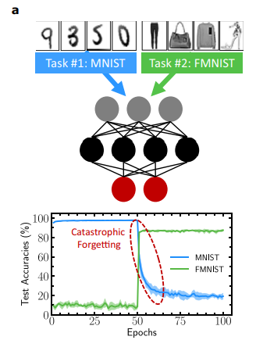
Continual Learning and Catastrophic forgetting
Synapses store and process
information simultaneously
Massive computational capability and less power consumption.
Searching for material synapses.
(Neuromorphic computing).

Slide 8
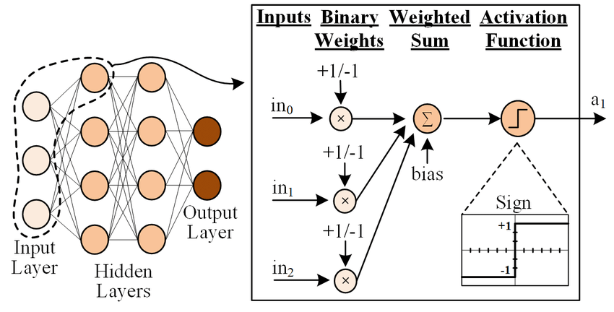
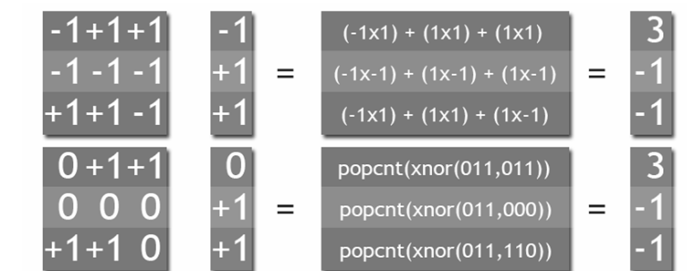
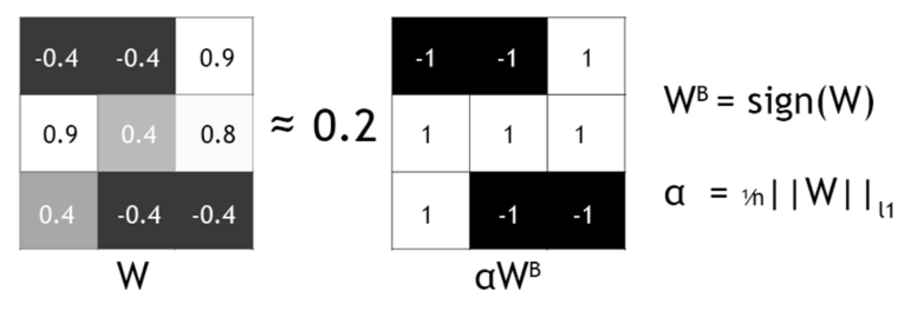
What is a Binarized Neural Network (BNN)?
Deep Neural Networks that use binary values (e.g. {-1,1} or {0,1}) for activations and synaptic weights.
BNN can perform computations using bitwise operations reducing the computation time.
From: https://www.researchgate.net/figure/A-typical-Binarized-Neural-Network-where-the-neuron-performs-weighted-summations-on_fig2_342258884net)
From: https://software.intel.com/content/www/us/en/develop/articles/binary-neural-networks.html

Slide 9
Binarized Neural Networks are important because…
They have a remote connection with the concept of metaplasticity.
Are one solution that tries to reduce the memory and computational requirements of DNNs while still offering similar capabilities of full precision DNN models.

Slide 10
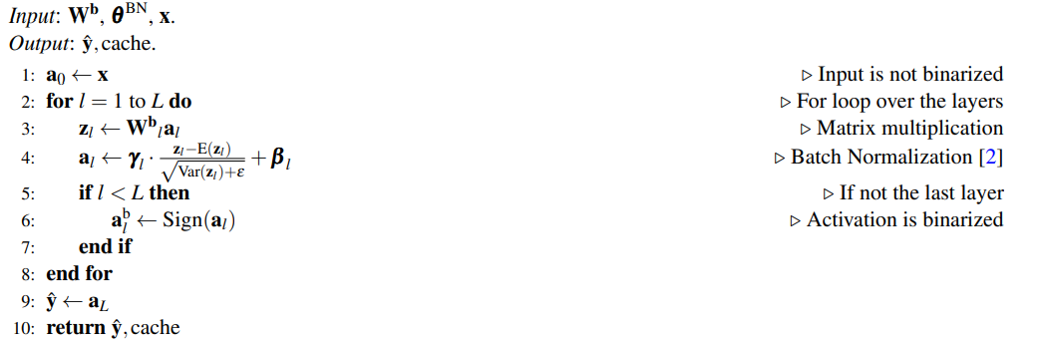
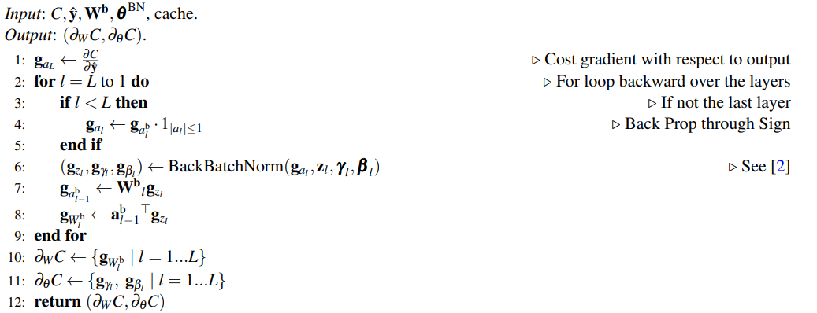
Forward function of the BNN
Training process of a BNN
Binary weights
Backward function

Slide 11
Forward function of the BNN
Training process of a BNN
Batch normalization parameters
Backward function

Slide 12
Forward function of the BNN
Training process of a BNN
Intermediate layers computations
Needed to be stored for the backward pass.
Backward function

Slide 13
RESULTS

Slide 14
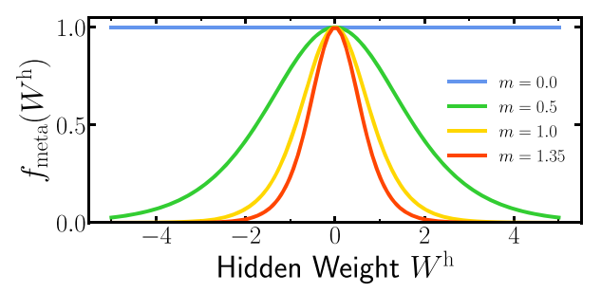
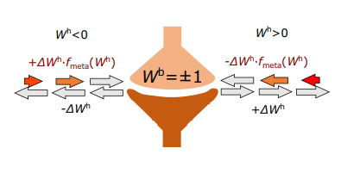






Hidden weights of a BNN are metaplastic states
$$∀x∈ℝ \text{and} ∀m∈ℝ^{+}:$$
$$f_{\text{meta}}\left(0,x\right)=1$$
Mechanism to introduce memory effects inspired from the cascade model.
$$f_{\text{meta}}\left(m,0\right)=1$$
$$f_{\text{meta}}\left(m,W^{h}\right)=1−\tanh^{2}\left(m W^{h}\right)$$
$∂_{x}f_{\text{meta}}\left(m,0\right)=$ 0
$$\lim_{\left|x\right|→ +∞}{f_{\text{meta}}\left(m,x\right)=0}$$

Slide 15
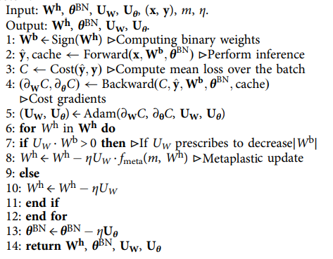
The proposed algorithm
Their contribution

Slide 16
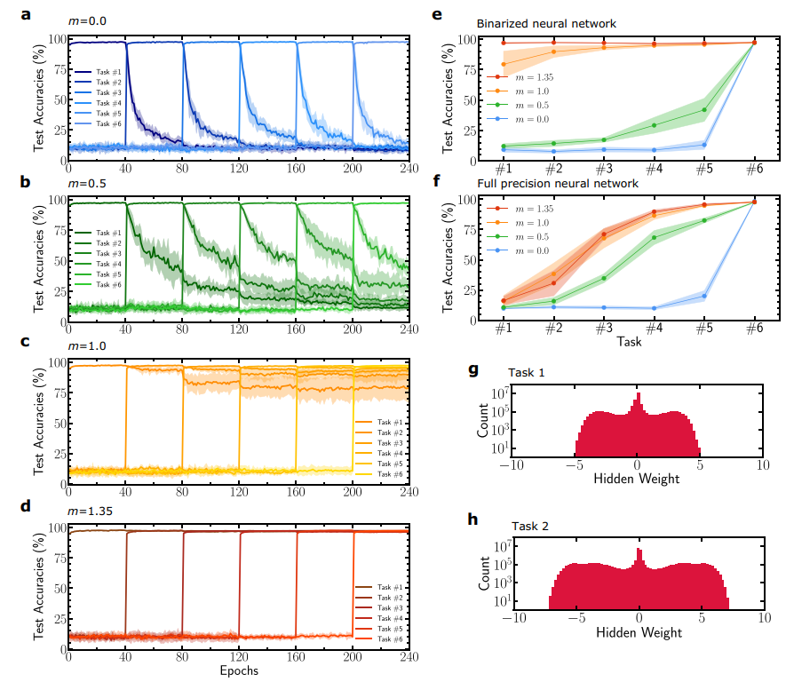
Multitask learning with metaplastic BNN

Slide 17
Multitask learning with metaplastic BNN

Slide 18
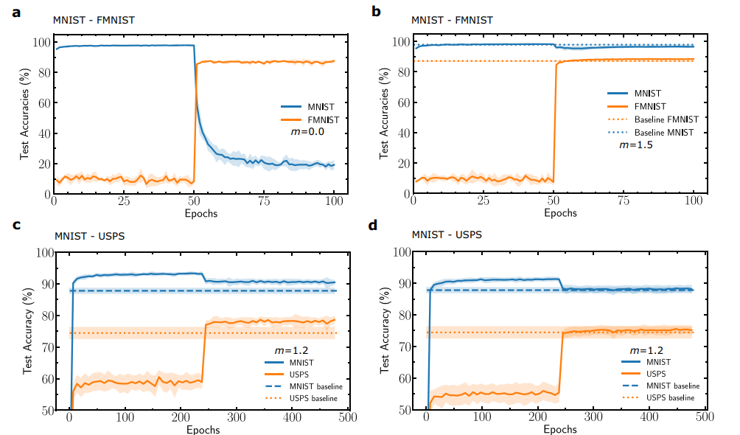
Sequential learning on various datasets

Slide 19
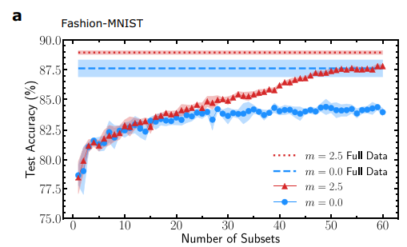
Stream Learning experiments
Learning one task from subsets of data
Tackle another aspect of catastrophic forgetting where all the training data is not available at the same time.

Slide 20
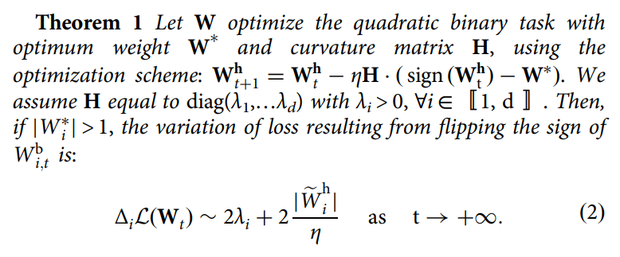


Mathematical interpretation for the hidden weights
Quadratic Binary Task:
Loss function:
$$ℒ\left(W\right)=\frac{1}{2}{\left(W−W^{∗}\right)}^{⊺} ⋅H⋅\left(W−W^{∗}\right)$$
$H∈ℝ^{d\text{×}d}$ is a symmetric definite positive matrix. Gradients are given by $g\left(W\right)=H⋅\left(W−W^{∗}\right)$
The gradient is evaluated using the signs of the hidden weight. So, assuming the optimization scheme:
$$W_{t+1}^{h}=W_{t}^{h}−η H⋅\left(\text{sign} (W_{t}^{h})−W^{∗}\right)$$
The bigger the loss increase upon flipping the sign of a binary weight, the more important it is for a given task.

Slide 21
Summary
The authors interpreted the hidden weights in BNN as a metaplastic variable.
They propose a new training algorithm for BNN adapted to learn different task sequentially and one task in a stream-type setting.
Their approach has a mathematical justification in the case of a tractable quadratic binary task.
Their work presents significant assets for future embedded and neuromorphic systems.

Slide 22
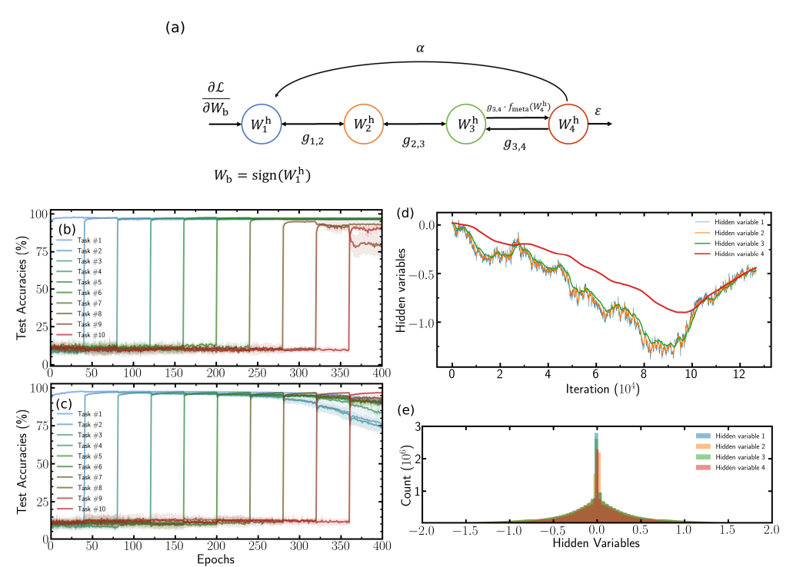
Adapting the approach to a more complex metaplasticity rule
They adapted their approach to a complex metaplasticity rule that achieved steady-state continual learning.

Slide 23
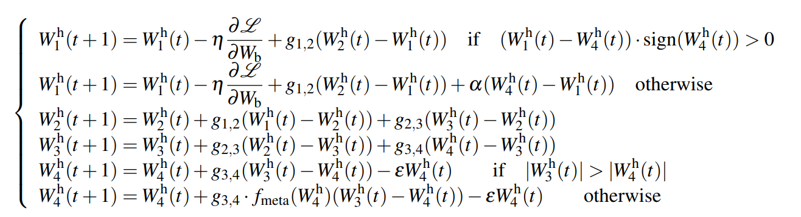
Adapting the approach to a more complex metaplasticity rule
Synapse model
Each synapse features four hidden variables which evolve according to:

Slide 24
Adapting the approach to a more complex metaplasticity rule

Slide 25
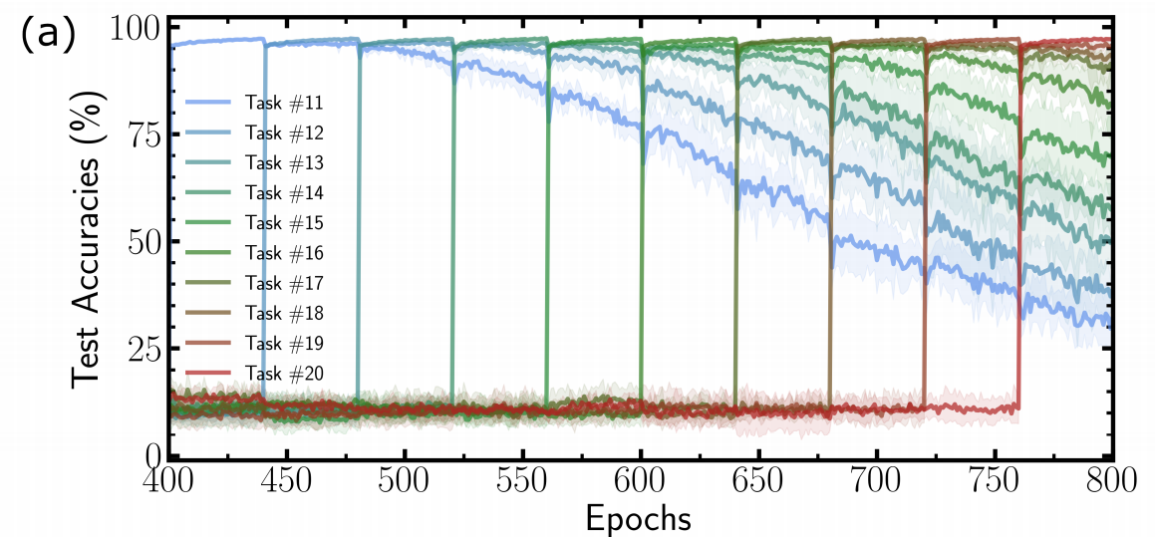
Adapting the approach to a more complex metaplasticity rule

Slide 26
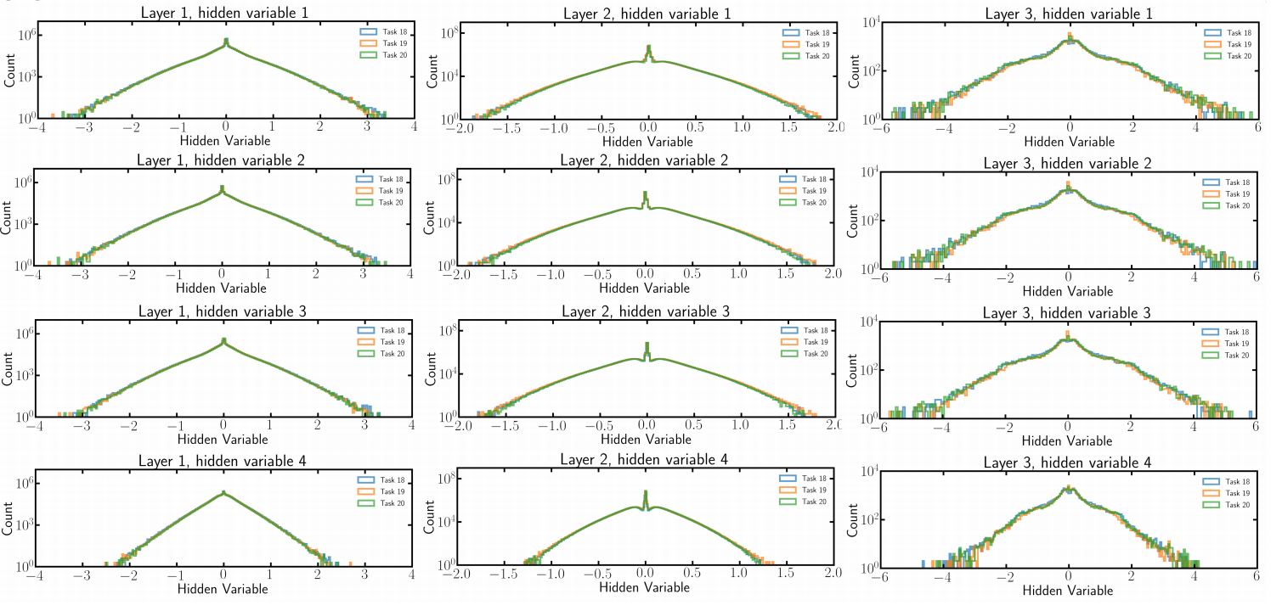

Slide 27
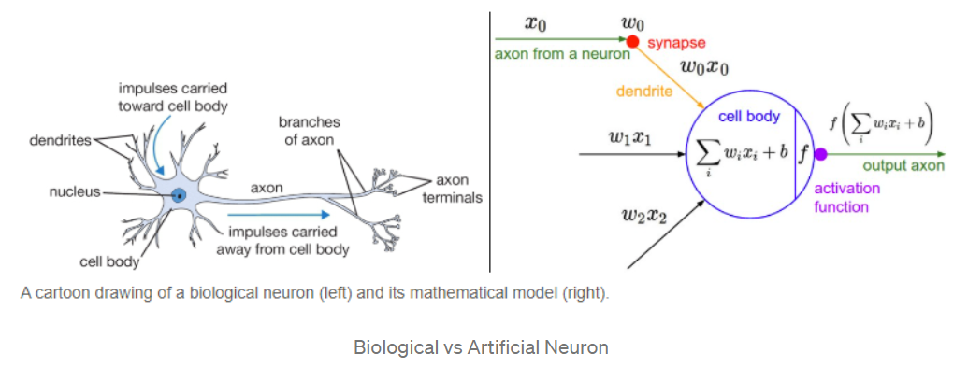

Slide 28
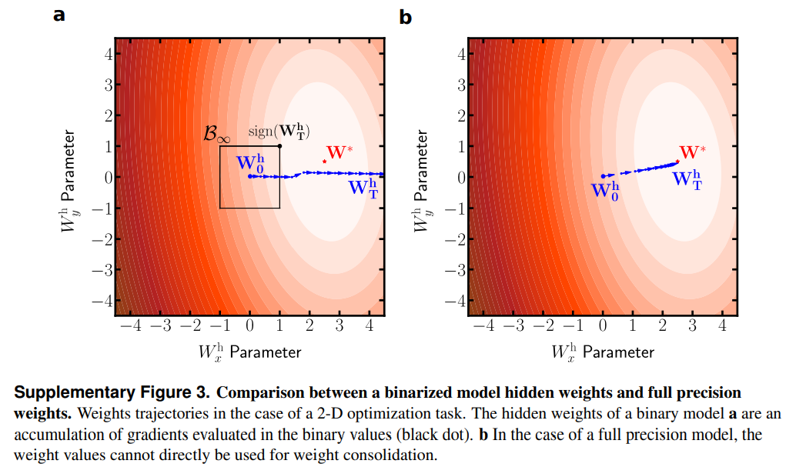
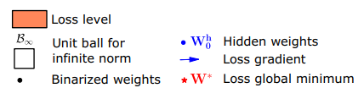


Mathematical interpretation for the hidden weights

